Slide 1
Deep learning Approach for Question and Answering (QA) Systems
Team Members: Ashwini Marathe and Srishti Saha
Notes:
Hello, This is Ashwini and Srishti. And we as a team will present our project implementation and results on Deep Learning for Question and Answering Systems.

Slide 2




Introduction
What?
Why?
How?
Question Answering (QA) systems enable users to retrieve exact answers for questions posed in natural language.
They are frameworks that produce answer ‘a’, given stories in the form of leading text pieces ‘T’ and a question ‘q’.
QA systems are intelligent dialogue systems.
They find application in chatbots or to simulate reasonable human-like conversations.
Industries that use QA models: Education, Medicine, Retail, for Customer Experience across industries etc.
QA systems are complex NLP tasks.
They employ models that can answer questions based on logic, reasoning and even understanding of natural language.
Notes:
To begin with, this is a bried introduction to the concept of QA or Question and Answering Systems. They are basically intelligent frameworks that provide exact answers for question that are posed to them in a natural language. So if you give them leading sentences that describe a scenario with and without relevant facts, also called stories and then pose a question based on some or all of those facts, the system is expected to give a reasonable answer in a natural language.
These systems find applications in chatbots, dialogue systems and in scenarios where there is a need to simulate human-like conversations. This makes them useful in industries like education, medicine and other industries which provide quality customer experience.
These models are complex NLP tasks and employ models that use both reasoning (or logic) and an understanding of the natural language (or vocabulary) to give accurate results.

Slide 3


Dataset
Simple Negation
Sandra travelled to the office.
Fred is no longer in the office.
The (20) QA bAbI tasks.
Source: https://research.fb.com/downloads/babi/
Examples of tasks: Single Supporting Fact, Yes/No Questions, Time Reasoning, Simple Negation, Path Finding etc.
Is Fred in the office?
No
Path Finding
The kitchen is north of the hallway.
The bathroom is west of the bedroom.
The den is east of the hallway.
The office is south of the bedroom
How do you go from office to bathroom?
North, West
Notes:
For this project, we have used the bAbI QA dataset curated and published by Facebook. This dataset has questions divided into 20 tasks. Each of these questions and answer sets have been generated by simulating a tightly controlled world. Some of the examples of these tasks are single supporting facts, Yes/no questions, time reasoning questions, Simple Negation and Path Finding, among others.
To give you an example of what a few of these tasks look like, let us look at a simple negation example: Given the 2 sentences in the story here, when a question “Is Fred in the office?” prompted to the system. The model is expected to find the relevant fact, “Fred is no longer in the office” and then generate a natural language answer: “No”.
Similarly, if we look at a little more complex example from Path Finding, the model will analyze the stories with both an understanding of natural language and reasoning to come up with a reasonable answer on how to get from one location to another. Here, the system provides a multiple word answer about how to go to the bathroom from the office, given the above supporting facts.

Slide 4
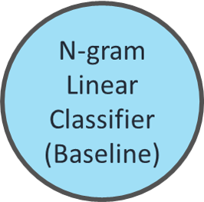
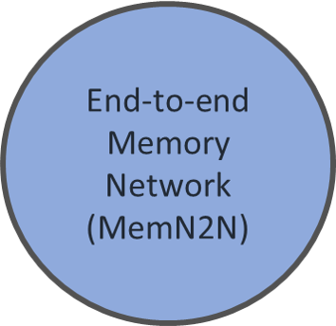
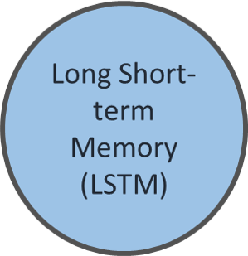
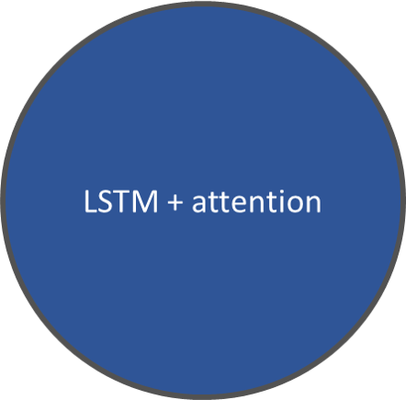
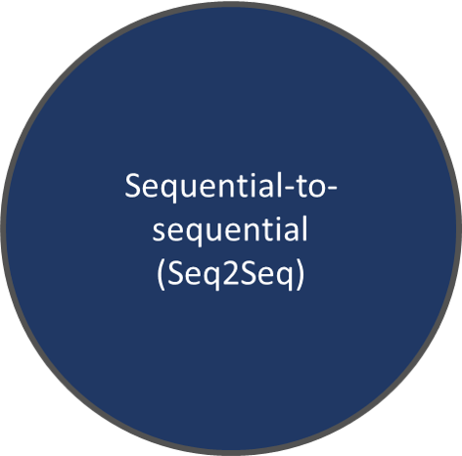
Methodology
GitHub repo for project implementation: https://github.com/srishtis/DL_final_project_ece685
Notes:
For the purpose of this project, we implemented 5 models, including the baseline model. The 5 models are: N-gram Linear Classifier , Sequential-to-sequential, Long Short-term memory (LSTM) model, LSTM with attention mechanism and an end-to-end memory network model. To begin with, let us briefly go over the baseline model.

Slide 5
N-gram Classifier (Baseline Model)
Bag of N-grams
1-gram
John is going to the kitchen.
2-gram
John is going to the kitchen.
Linear Support Vector Classifier
Features: Vocabulary from bag of N-grams from stories
Target: Encoded vocabulary from answer sets
Q: Where is John?
A: Kitchen
Notes:
An N-gram language model extracts and creates sequence of N words that occur together in a piece of text. For this model, we extracted both 1-gram (1 word features) and bi-grams (combinations of 2 words as features) from the story. Once that was done, this bag-of-Ngrams were passed into a linear Support Vector Classification model as the feature set.
The target variable of this model was the list of all answers that were contained in the training set. Thus, in this example, given the story: “John is going to the kitchen”, the model will be able to predict the answer to the question “Where is John” as “kitchen”, simply from the vocabulary set and observed QA sets in the training data.
It is important to note that since the unigram model takes the individual words as its feature set, it is not accounting for the sequence of these words. It is also not accounting for a reasoning beyond the language of this vocabulary. Thus, it might perform suboptimally in tasks where the sequence of the words, construct of the story sentences or any kind of reasoning is important. Incorporating bigrams might mitigate some of the issues related to the sequence of the words, but not completely.

Slide 6
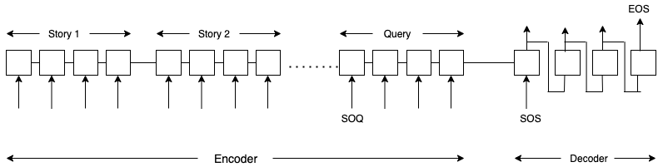
Sequential-to-sequential (Seq2Seq)
I like tea but not coffee
I like coffee but not tea
Encoder output
north
west
The bathroom is west of the bedroom
The office is south of the bedroom
How do you go from office to bathroom?
Notes:
The n-gram model works on the frequency of word occurrence in documents but does not consider the order of words. For example, consider the two statements here. Both the statements have exactly same words but the change in ordering changes the semantics of the statement. The sequence to sequence model considers this ordering by using encoder-deocoder archtitecture. The stories are fed to encoder word-by word. Next the query words follow after a Start of query symbol. Once we get the encoder output, it is used as input to the decoder. The first RNN block of decoder takes as input the output from encoer and start of sequence symbol. It then tries to predict the output tokens as shown.

Slide 7
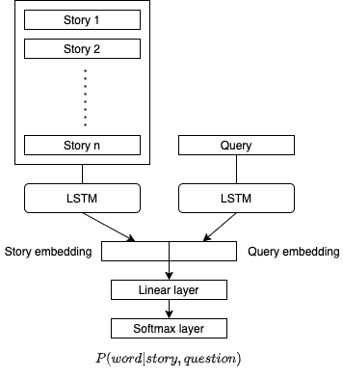
LSTM based sentence embedding
Use sentence embedding to create embedding for Stories and queries
Pass the sentence embeddings through a LSTM module
Concatenate the LSTM outputs
Pass through a Linear layer
Use a softmax layer to get output probabilities
Notes:
Next we tried sentence embedding using LSTM. First the stories and query are passed through two embedding layers. The joint story embedding and query embedding are then passed through an LSTM module. Outputs from LSTM modules are concatenated and passed through a linear layer . A softmax layer is used in the end to get the probabilities of the answer over the vocabulary.

Slide 8
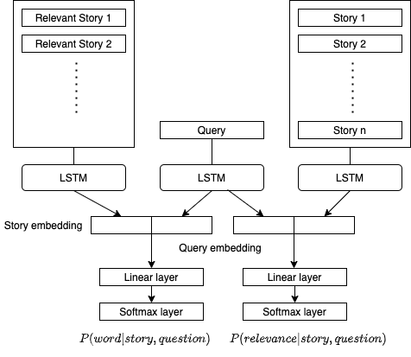
LSTM + Attention
The dataset contains for information about the stories that are relevant in answering query.
For example,
Mary went to the bathroom.
John picked up the football.
Mary travelled to the office.
Bob went to the kitchen.
Query: Where is Mary?
Answer: office
Joint modeling
Learn to select relevant stories and learn the answer from the relevant stories!
Notes:
We tried incorporating attention mechanism in the LSTM based sentence embedding model. The babi dataset has information about the relevant stories for each query. For example, consider the set of statements below.
This query can be answered by statements 1 and 3. A successful model should learn to focus more on relevant stories and ignore irrelevant stories. To achieve this we did joint modeling. The left part of model is very similar to the LSTM model discussed in last slide, except the input is only the relevant stories. The network on the right tries to learn which stories are relevant and uses the relevancy signal from the data to calculate the loss. The model tries to minimize the sum of losses and thus learns to pay attention to relevant stories.

Slide 9
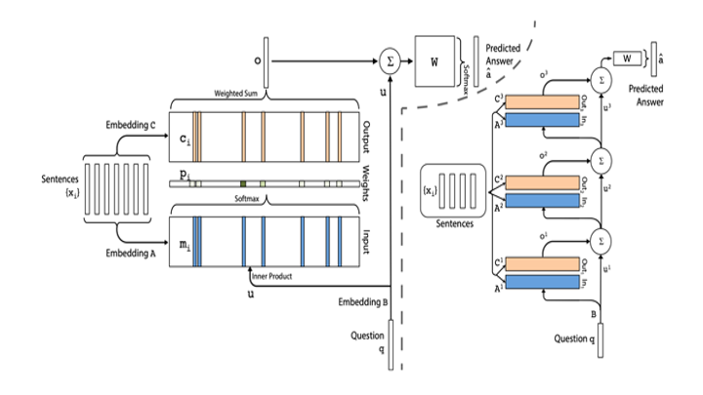
End-to-End Memory Network
Notes:
This model proposed in a paper titled end to end memory network achieves state of the art results on this dataset. The input stories are embedded using a matrix A and the query is embedded susing matrix B. Each story is rated by taking a dot product with the query embedding. This is similar to the attention mechanism., where higher the dot product, higher is athe attention paid to the story. The stories are passed through another embedding. The final output is a weighted sum of attention to be paid to the story and its embedding. The model can be extended stacking layers of the module, where the input of module is the output of the previous module.

Slide 10
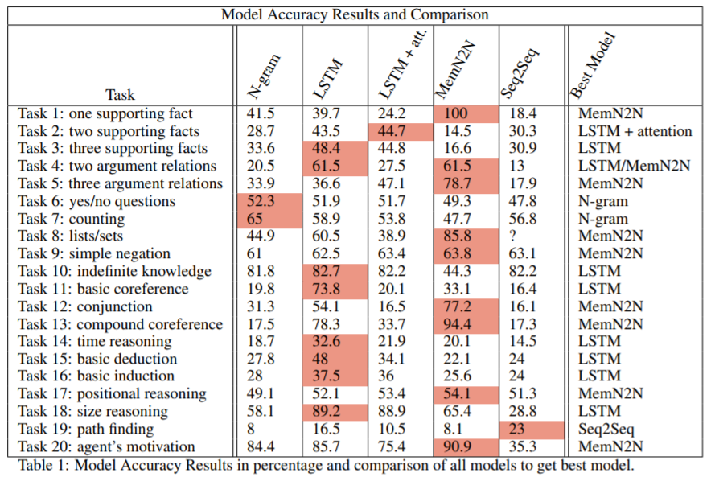
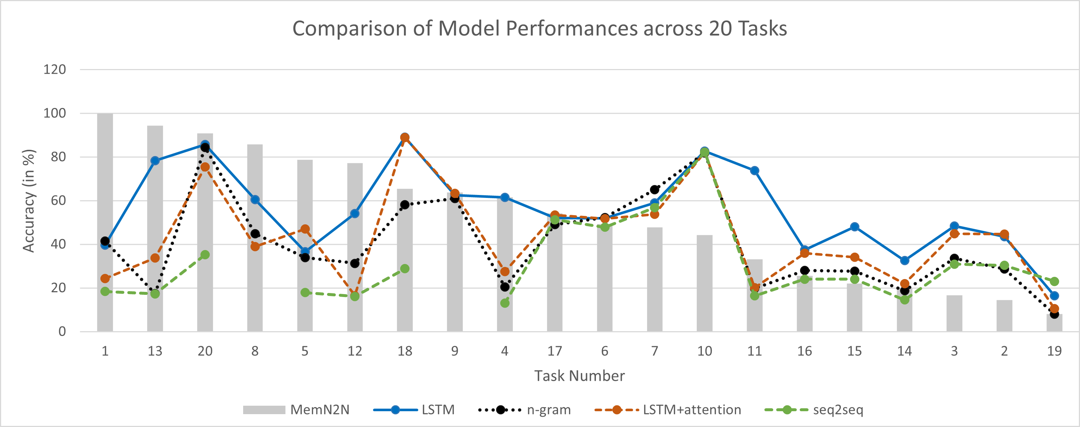
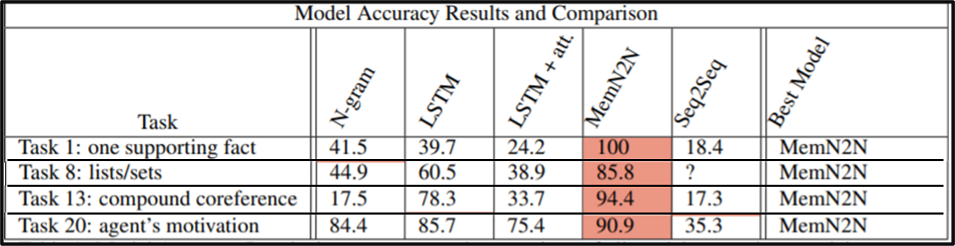
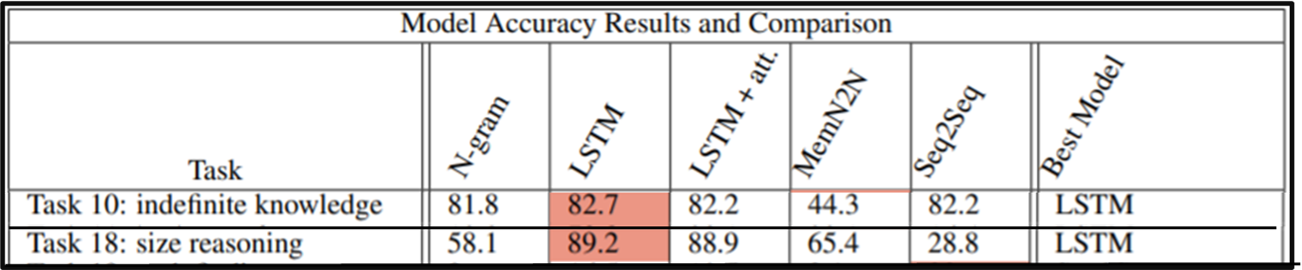
Model Results and Comparison
Best Model across all tasks
Proposed Models
MemN2N
Model Results
Trends for model comparison
LSTM
Proposed Models for some tasks
Notes:
Here we present a comparative study of the model results. One of the key observations from the model accuracies of the 5 models across all tasks is that, the end-to-end memory network has performed the best among all other models. It has given the best accuracy in 9 out of 20 tasks, the highest being 100% in task 1 i.e. Single supporting fact.
It has also performed well in task 8 (lists/sets) where the expected answer was multi-word answers. Here, the seq-to-seq model had failed to perform. It is interesting to note that our baseline Ngram model has performed well on tasks 6 (yes/no), 7 (counting) and 20 (agent’s motivation). This might be attributed to the construct of this particular dataset wherein the vocabulary is limited for these tasks. Hence, the model might be performing well for these scenarios as it only uses the available vocabulary. This means that this model might not perform well when trained on a more generic dataset that is not simulated from a tightly controlled world.
Another interesting observation we made here is that all models have given a fairly equal accuracy for task 6 (yes/no questions). We imagine this might be happening because the probability of both outcomes is approximately 50% and calculating the accuracy of a model might not be capturing the drawbacks of the predictions.
This graph captures the trend of accuracies of our models across all the tasks. The bars are the accuracies of our best performing model i.e. MemN2N. If we look at the trend of these model accuracies, we see that for task 18 (size reasoning), 2other models i.e. LSTM and LSTM+attention performed better than our best performing model(MemN2N).
Based on the results obtained, we see that End-to-end Memory networks (MemN2N) is a reliable model for solving tasks 1 (single supporting fact), 13 (compound coreference), 20 (agent's motivation) and 8 (lists/sets). On the other hand, the LSTM (long short-term memory) model is an accurate framework for questions belonging to tasks 18 (size reasoning) and 10 (indefinite knowledge).
Having said that, we see the possibilities of improvements to the current models. This work can be extended to experiment with bidirectional LSTMs/GRUs in the sentence embedding models. The positional and temporal encoding can be incorporated for the baseline model. Since bAbI is a small dataset that has been constructed from a highly constrained simulated world, it might be helpful, if we build and train our models on more generic question answer datasets.

